Slide 1
Lesson 2 – Output
Lets output some code
Ben Schwarz

Slide 2
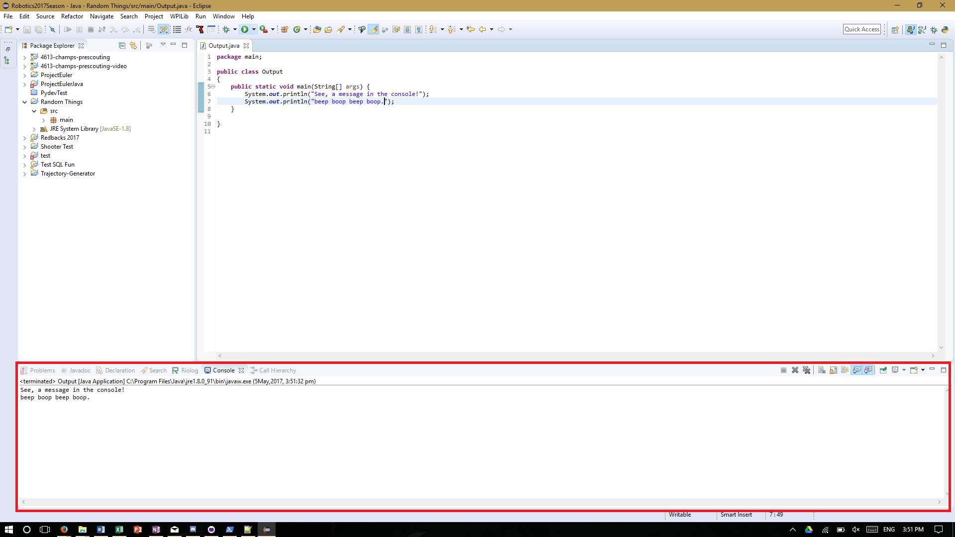
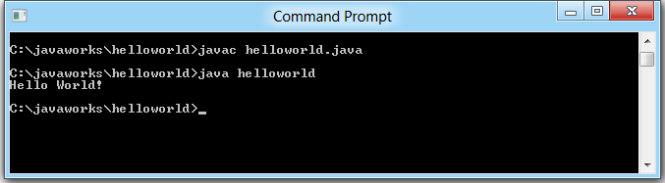
Lesson 2: Output!
Ability to output data is important. What would the point of computers be otherwise?
This can take place in several in forms: a console, GUI (graphical interface), speaker etc.
A console is the most common, and this is what we will be using.
A console is just a text stream. In Eclipse it’ll be at the bottom of the program
Note a console doesn’t have to look like that - a common one is the cmd.

Slide 3
First, Create our Project and Class
To create a new java project, go Ctrl+N. Or do it under the new tab
From here go Java > Java Project > Next. Give it a nice name and click next
From here you want to create a new class. Java likes to wrap things up and for us our code needs to be wrapped up in a class (And the class in a project). Go ctrl+N again then New > Class
Give your class a nice name. By convention Class names are UpperCamelCase (start of each word capitalized). No spaces!
Under “which method stubs would you like to create?” message, tick public static void main(String[] args). Then click next.
You'll see a lot of junk in the file. We really weren't lying when we said Java likes to wrap things up. Trust us, it's not as insane as it sounds.

Slide 4
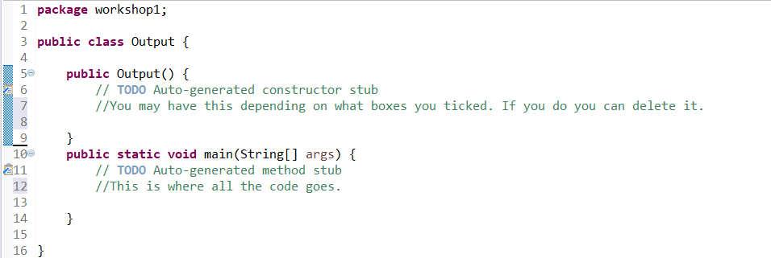
You should have something like this:
See where it says, “public static void main(String[] args) {” this is a function (A function is just a bunch of code which does stuff). Java always looks for this code and implements what ever is inside it. As such we should put our code here.
Now we can start typing!

Slide 5
Actually Outputting!
In order to write to the console write: “System.out.println()”
Note, println is short for printline. Make sure not to write print1.
Also make sure you are writing the code inside the main function.
Inside the brackets write something inside of quotations. We suggest “Hello World”. This is traditionally a programmers first program.
Add a semicolon on the end “;”. This tells java it’s the end of a line. It’s required for every line that does something. (E.g. outputs)
Now hit the play button (green triangle) which is along the row of icons.
Check the console. What do you see?

Slide 6
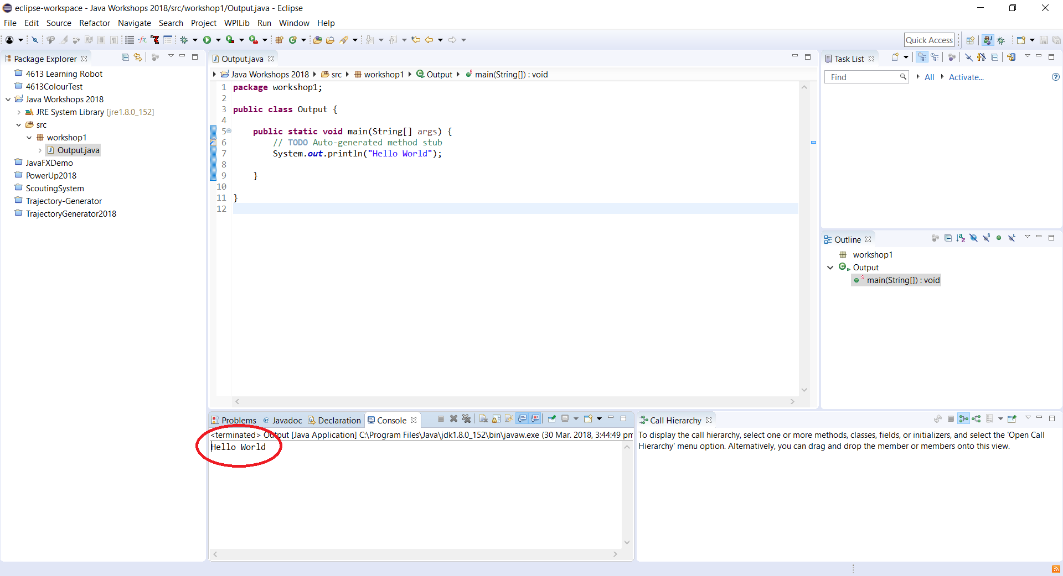
If you had trouble, here’s my example

Slide 7
Activities:
Try changing the text to whatever you want
Try changing the text to a number and removing the quotes. Gasp!
Now try text without quotes. It won’t work but see what it says.
You can add together elements to print them with a + sign between things like strings and integers ("Pot"+"ato"). Try printing multiple separate Strings. (A string is something in those quotes, we will cover this later).

